Slide 1




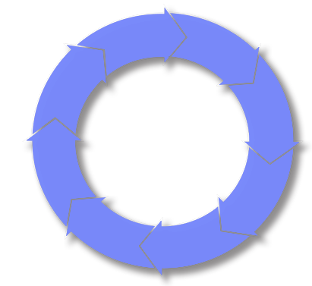








Business
Executive
End User
Define Requirements
Model the Business
Govern
Analyst
Operations Manager
Optimize
Analyze
& Design
Project Manager
Manage change
& assets
Architect
Application Support
Manage
Implement
Deploy
Developer
Test
Operations
Deployment Manager
Tester
Development
Notes:
3) Business Driven Development Lifecycle
Message -> Benefits of using an iterative approach to developing applications that start with modeling a business and then cycles through Requirements, Analyze & Design, Implement, Test, Deploy, Manage and Optimize phases to validate and broaden awareness of business needs.
Message -> Identify Rational products and how they are used in Business Driven Development by each role
The Business-Driven Development life cycle is iterative in nature. Each iteration combines a mix of analysis, design, construction and testing activities and results in a demonstrable form of the software that can be validated and refined by users. Producing multiple iterations reduces project risk by providing tangible checkpoints along the pathway to a complete solution. A typical iteration includes the following 8 steps with examples of Rational products.
1) Model the Business Process
IBM solutions enable you to capture current business activities and workflows and simulate alternative scenarios to determine the best opportunities for business transformation.
Rational Software Architect
Rational Software Modeler
WebSphere Business Integration Modeler
2) Analyze Requirements
Once a solution has been identified, the next step is to define its supporting business and IT requirements. IBM solutions help you generate a financial analysis for your proposed solution and document both its business and technology requirements. By modeling user interactions using the industry-standard UML, your team will share a common and precise understanding of proposed changes.
Rational RequisitePro
3) Analyze & Design Applications and 4) Construct/Implement Application
The next step is to translate requirements into technology solutions. Because no single tool fits all team needs, IBM offers the broadest spectrum of code-based, model-driven and rapid application development solutions for developing high-quality software. You choose the toolset optimized for your technology environment, skill level and development paradigm.
Rational Software Architect
Rational Application Developer
5) Test Application
Each iteration is validated to ensure that it functions as designed with acceptable performance. IBM testing tools accelerate quality assurance activities as they build a valuable foundation of reusable test artifacts.
Rational Functional Tester
Rational Manual Tester
6) Deploy
IBM deployment tools support a managed approach to planning and executing migrations to your production environment. Automated provisioning and configuration management capabilities ease the implementation of coordinated changes to business processes and IT systems.
Rational Performance Tester
WebSphere Studio Application Monitor
7) Manage
Once deployed, IBM monitoring tools monitor applications and essential system resources across your multiplatform environment to detect potential problems and automate recovery from critical situations. A closed-loop development cycle provides developers, operations managers and network engineers with a consistent set of correlated data to pinpoint application problems and facilitate their rapid repair and redeployment.
Tivoli Enterprise Console
Tivoli Monitoring for Transaction Performance and……..a host of other Tivoli Monitoring products
8) Optimize
Successful organizations not only automate business processes, but also monitor their execution and dynamically adjust them in response to real-time feedback. A performance-based feedback cycle allows you to compare the projected value of an investment to actual business results and make the necessary adjustments to maximize business value.
WebSphere Business Integration Monitor

